Slide 1

IMAGINE what Midstate Can Do for You

Slide 2
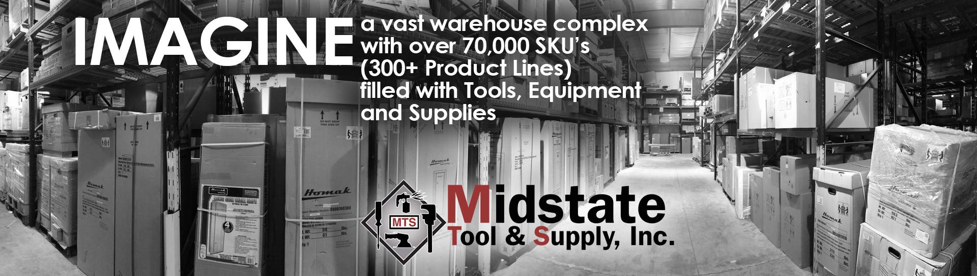
IMAGINE

Slide 3
IMAGINE
IMAGINE
all of these products available to you - to sell to your customers

Slide 4

IMAGINE
^{all of these BRAND-NAME} ^{products}
IMAGINE
all of these products available to you - to sell to your customers

Slide 5
IMAGINE
^{all of these BRAND-NAME} ^{products}
300+ PRODUCT LINES
IMAGINE
all of these products available to you - to sell to your customers

Slide 6
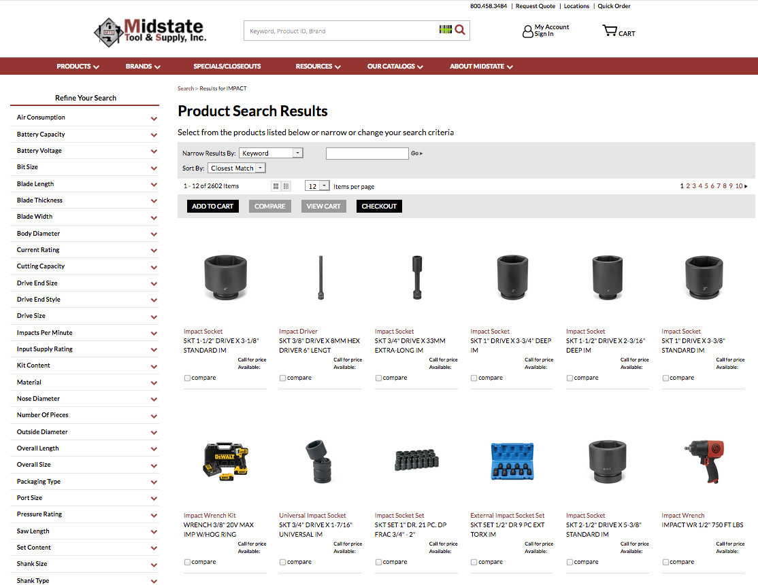
IMAGINE
IMAGINE
a useful, searchable, content rich
website that allows you to order these products

Slide 7
IMAGINE

Slide 8
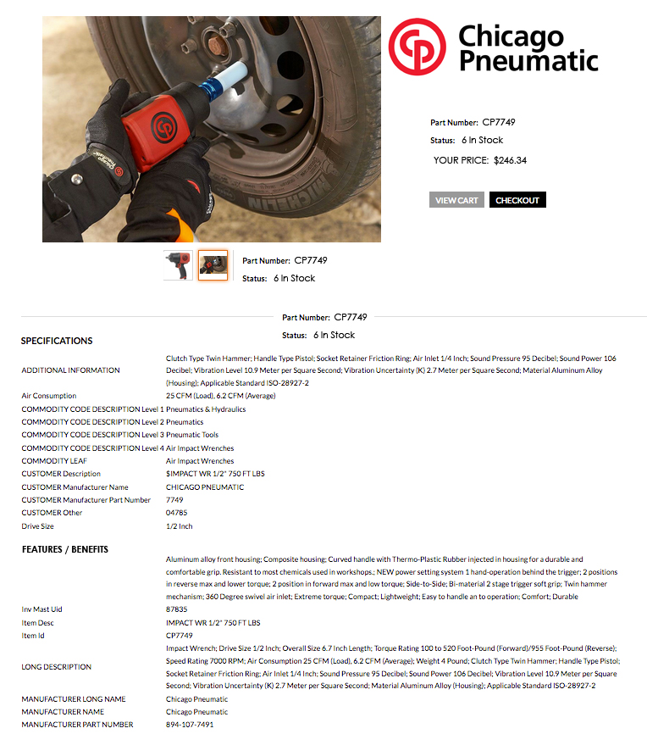
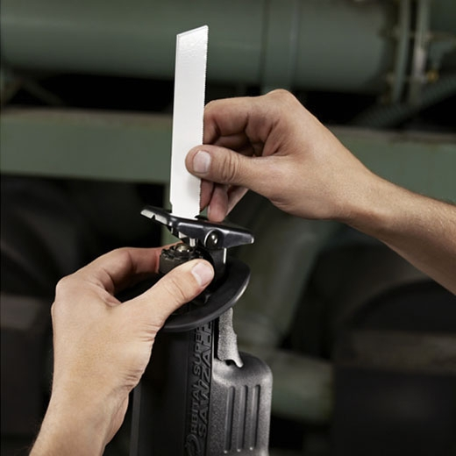
IMAGINE
IMAGINE
a useful, searchable, content rich
website that allows you to order these products

Slide 9
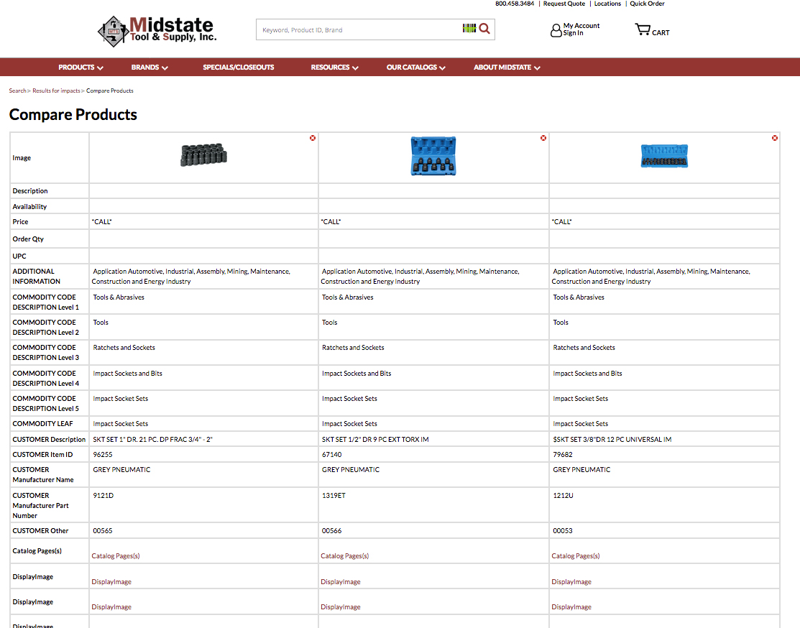
IMAGINE
IMAGINE
a useful, searchable, content rich
website that allows you to order these products

Slide 10

IMAGINE

Slide 11
IMAGINE
Midstate Strategic Location of Warehouse, Altoona, PA
75% of Customers Receive Delivery in Two Days or Less

Slide 12

IMAGINE
IMAGINE
a friendly and informed customer service team available to support
you via phone (during weekday business hours)

Slide 13

IMAGINE
IMAGINE
a catalog marketing program, that features the products from this warehouse, with catalogs that you can give to your customers.

Slide 14

IMAGINE
IMAGINE
events and training opportunities to keep you well-informed about the latest tools & equipment

Slide 15
IMAGINE
IMAGINE
adding all of this to what you currently offer to your customers without:
to your business!
adding any staff,
infrastructure or
inventory

Slide 16
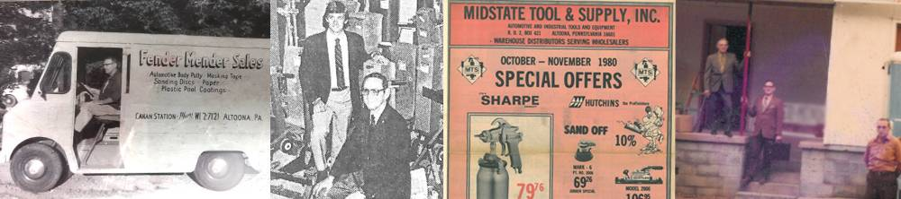
IMAGINE
With Midstate Tool & Supply, IMAGINATION is REALITY
Midstate Tool & Supply, Inc. is a Master Warehouse distributor that has been serving customers for over 45 Years. We offer unparalleled support of customers with rapid order fulfillment and a complete line of marketing tools. We pushing on-ward into future with a major investment in our website offering more information and greater search-ability. With this investment will come more ways to offer our products to your customer. Feel free to visit: www.midstatetool.com to explore the possibilities.

Slide 17
IMAGINE what Midstate Can Do for You

